Slide 1
2. Quantization and entropy coding
Xavier Serra

Slide 2
Index
Scalar quantization: uniform, non-uniform, differential PCM
Vector quantization
Bit-allocation algorithms
Entropy coding: Huffman coding

Slide 3
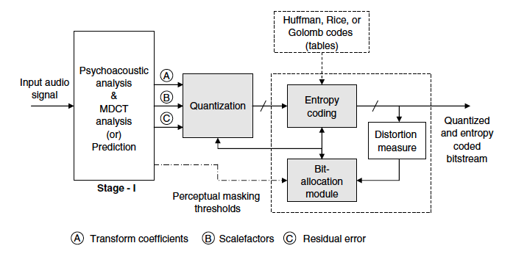
Quantization - Bit Allocation - Entropy coding module

Slide 4
Quantization
Definition: binary representation of signals.
Data reduction by removing irrelevance.
Explicit control of quantization distortion according to time/frequency-dependent masking threshold (perceptual coder).
High variability in local SNR (e.g. 0db ..> 30db).
Types of quantization:
Memoryless (ex. PCM) or with memory (DPCM). Whether the encoding rules rely on past samples or not.
Uniform or nonuniform. Based on the step-size or the quantization (discretization) levels employed.
Scalar or vector (VQ). Whether each sampled is quantized individually or blocks of samples and quantized jointly.
Parametric or nonparametric. Whether the actual signal is quantized or signal transforms are used before quantization.

Slide 5


Probability density functions
A random process can be characterized by its probability density function (PDF), which is a non-negative function p(x), whose properties are
and
the PDF area, from x1 to x2, is the probability that the random variable X is observed in this range.

Slide 6


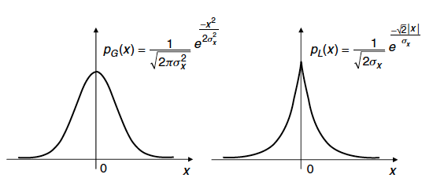
The mean and the variance of X are defined as
PDFs are useful in the design of optimal signal quantizers as they can be used to determine the assignment of optimal quantization levels.
Gaussian PDF
Laplacian PDF

Slide 7
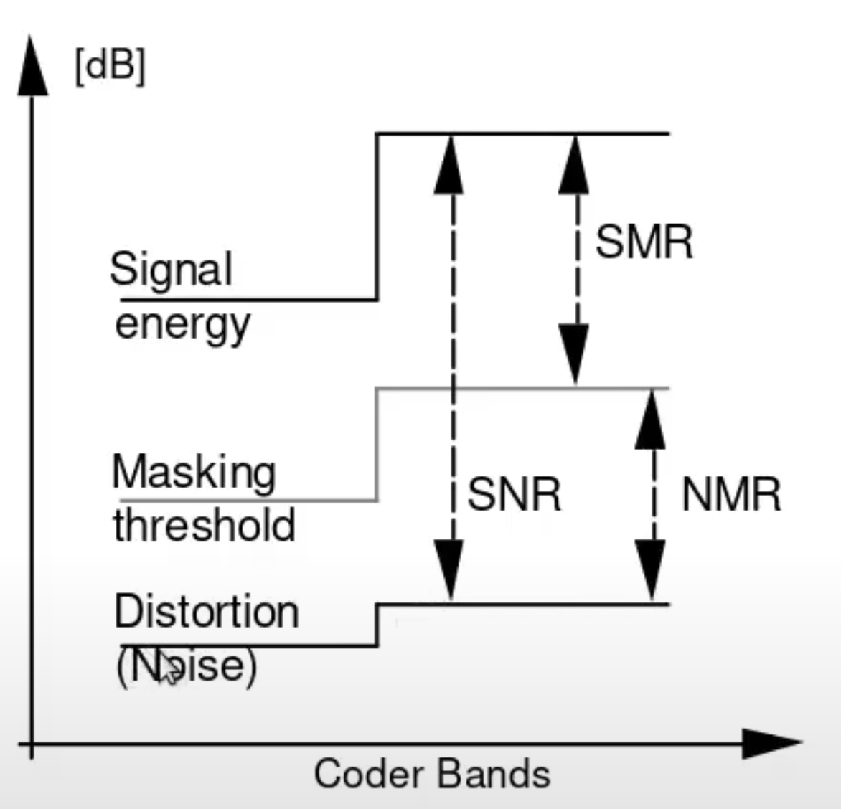
Quality and rate measures
Signal-to-Noise Ratio (SNR)
Quadratic distortion measure
Noise-to-Mask Ratio (NMR)
Ratio of distortion with respect to masking threshold
Determines audibility of distortion
Should be as small as possible (<= 0 dB)
Signal-to-Mask Ratio (SMR)
Relation between signal and masking threshold
Gives indication of bit demand

Slide 8
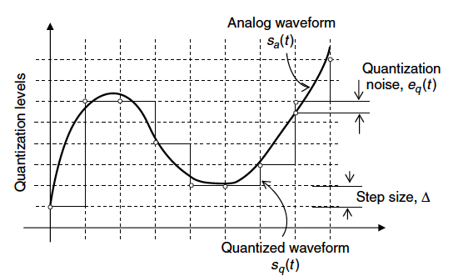
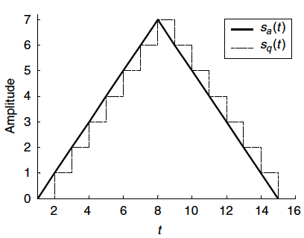
Scalar quantization: uniform
Uniform PCM is a memoryless process that quantizes amplitudes by rounding off each sample to one of a set of discrete values.

Slide 9




The difference between adjacent quantization levels, i.e., the step size ∆, is constant.
The number of quantization levels, Q, is Q = 2^Rb, where Rb denotes the number of bits.
The performance of uniform PCM can be described in terms of signal-to-noise ratio, SNR =
Consider a signal s is quantized in the interval (-smax, smax). A uniform step size is A
Let's assume a quantization noise with uniform PDF,
The variance of the quantization noise is
Increase of 1 bit reduces the noise variance by a factor of four and improves the SNR approximately by 6dB.

Slide 10
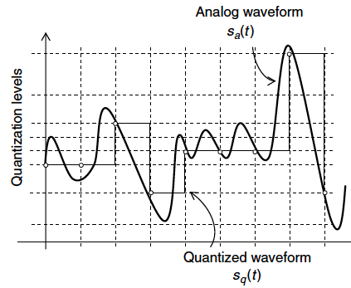
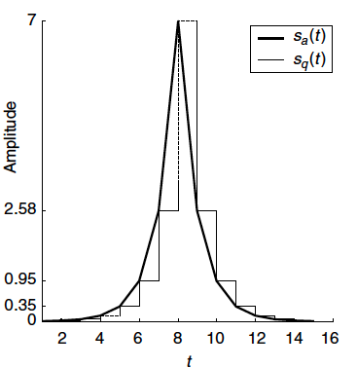
Scalar quantization: non uniform

Slide 11
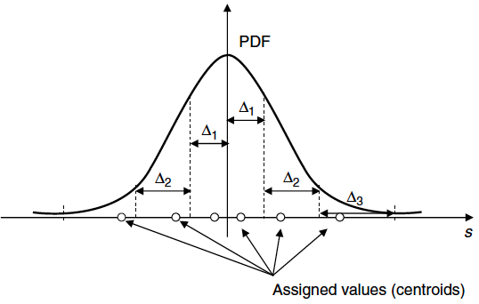
PDF-optimized PCM
Non-uniform PCM quantizers use a non uniform step size that can be determined from the statistical structure of the signal.
PDF-optimized PCM uses fine step sizes for frequently occurring amplitudes and coarse step sizes for less frequently occurring amplitudes.
A signal with a Gaussian PDF can be quantized more efficiently by computing the quantization step sizes and the corresponding centroids such that the mean square quantization noise is minimized.

Slide 12

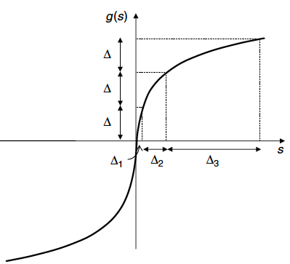
Log quantizers
g(.) maps non-uniform step sizes to uniform step sizes, such that a simple linear quantizer is used.
Two telephony standards have been developed based on logarithmic companding, i.e., the μ-law (in USA) and the A-law (in Europe).
Companding schemes have been found to reduce bit rates, without degradation, by as much as 4 bits/sample relative to uniform PCM.
Companding function for non uniform PCM

Slide 13

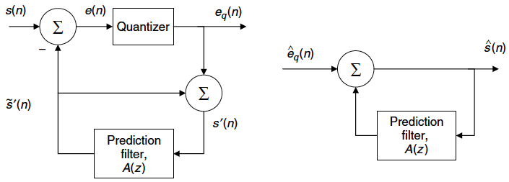
Differential PCM
DPCM removes redundancy in the signal by exploiting the correlation between adjacent samples.
Simplest DPCM encodes only the difference between successive samples.
Common DPCM incorporates short-term prediction process:

Slide 14
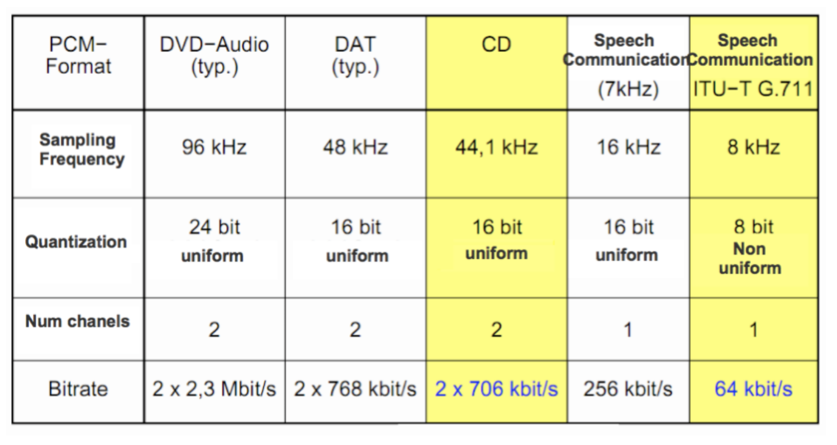
Common PCM formats based on scalar quantization

Slide 15
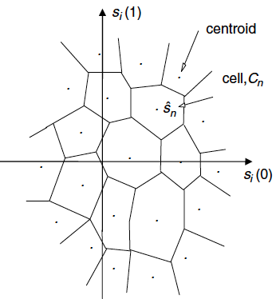
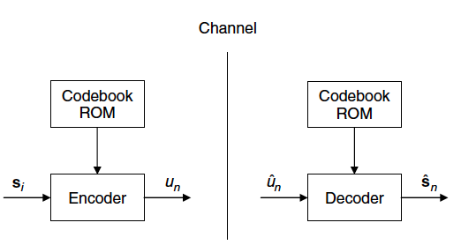
Vector quantization
VQ is achieved by encoding a data-set jointly in block or vector form.
Cells for two-dimensional VQ

Slide 16

The quantizer maps the i-th incoming N vector given by T to a n-th channel symbol
The codebook consists of L code vectors, which reside in the memory of the transmitter and the receiver.
The input vectors are compared to each codeword and the address of the closest codeword determines the channel symbol to be transmitted.
The most commonly used distortion measure is the sum of squared errors,
Fixed codebooks are designed a priori and the basic design procedure involves an initial guess for the codebook and then iterative improvement by using a large number of training vectors.

Slide 17
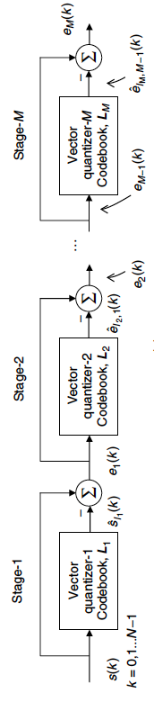
Structured VQ
The complexity of high-dimensionality VQ can be reduced with the use of structured codebooks that allow for efficient search.
Multistep vector quantizers consist of a cascade of several quantizers each one encoding the error or residual of the previous quantizer.

Slide 18
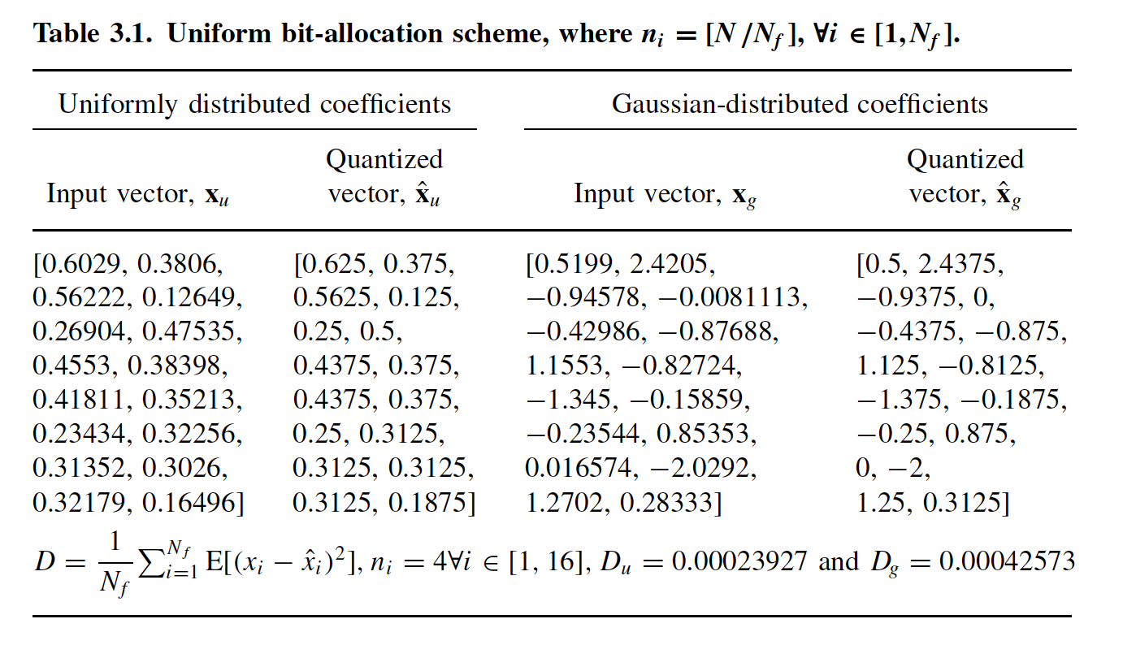
Bit-allocation algorithms
A bit-allocation algorithm determines the number of bits required to quantize an audio frame with reduced audible distortion.
Bit-allocation can be based on perceptual rules or spectral characteristics.
N = 64 bits available, N_f = 16 samples -> n_i = 4 for all i

Slide 19
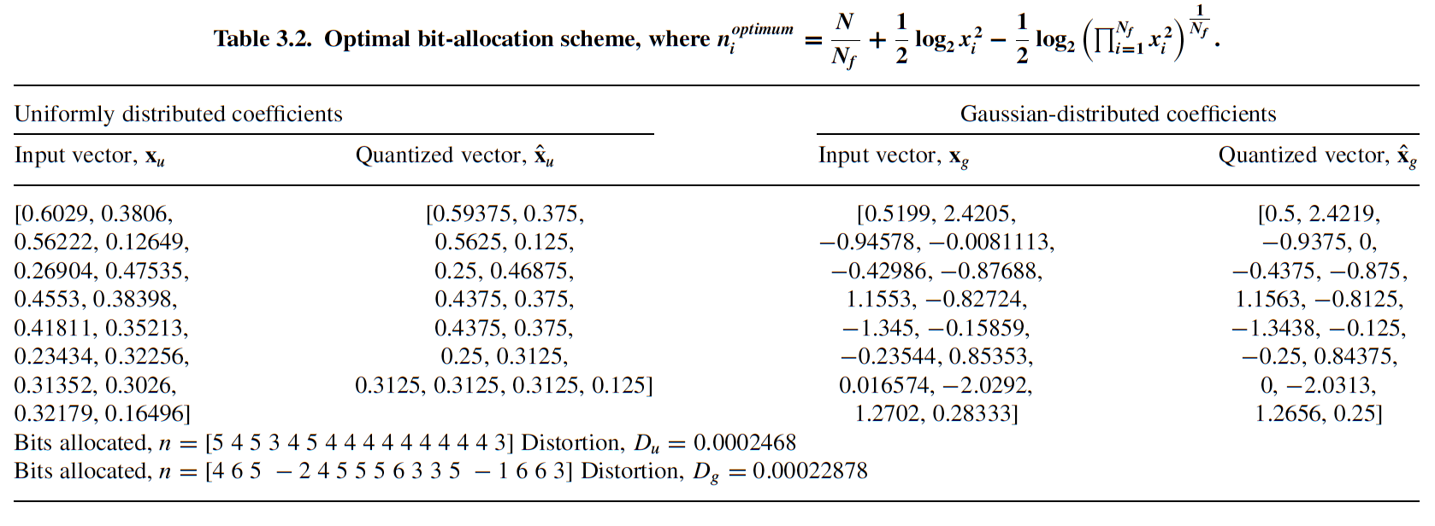
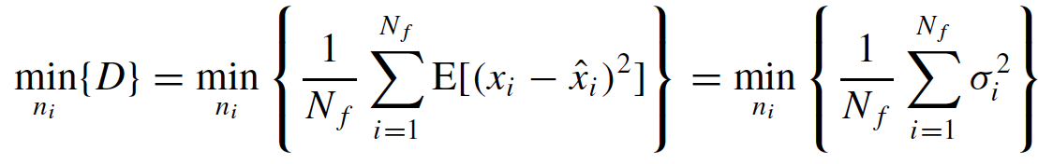
We can define a cost function that minimizes the distortion

Slide 20

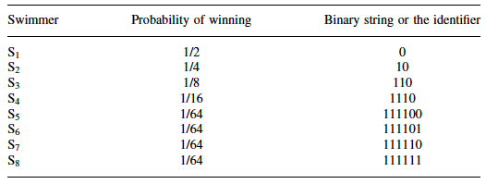
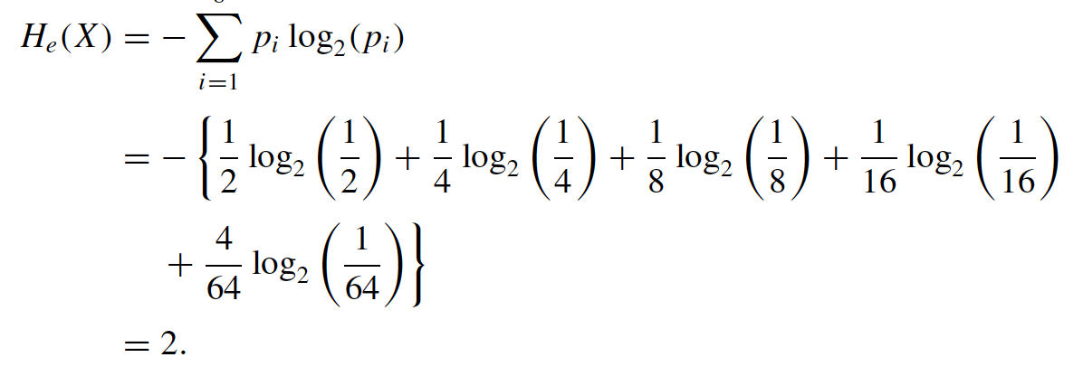
Entropy coding
Definition: lossless compression based on exploiting statistical correlations of the data.
Entropy is a measure of uncertainty of a random variable.
Shannon proved that the minimum number of bits required to encode a message, X, is given by the entropy, , where p_i is the probability that the i-th symbol is transmitted.
Typical probability of audio samples: Laplace distribution.
-> 2 bits with entropy code, 3 bits with uniform code.
Example of an entropy code

Slide 21
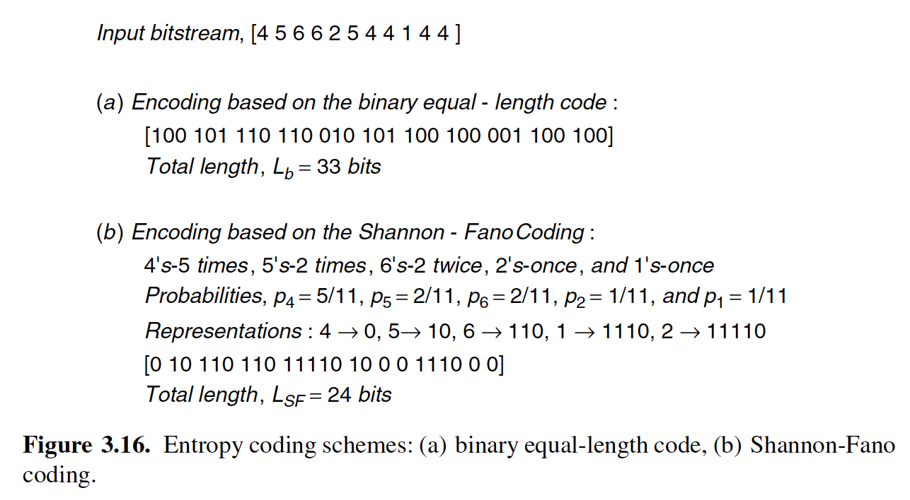

Slide 22
Statistical entropy alone does not provide a good measure of compressibility in the case of audio coding. Quantization noise, masking thresholds, and tone- and noise masking effects must be accounted for.
Most popular entropy coding approach: Huffman coding.

Slide 23
Huffman coding
Technique to construct minimum redundancy codes.
Uses the probability of the symbol to determine the codeword.
Regarded as the most effective compression method, provided that the codes designed using a specific set of symbol frequencies match the input symbol frequencies.

Slide 24
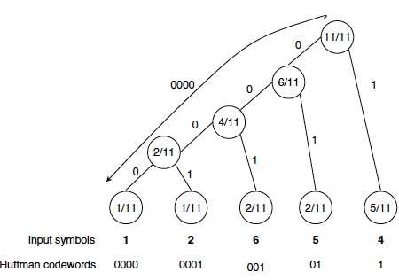
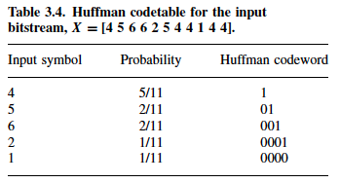
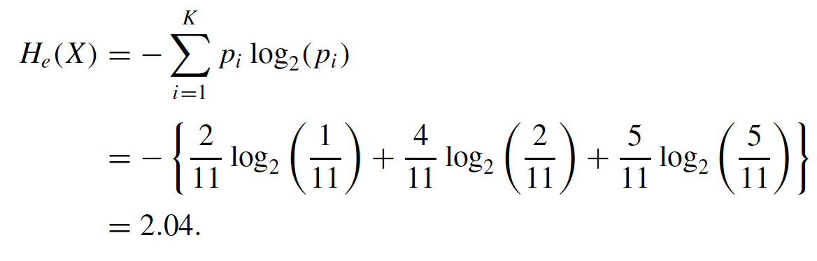
Huffman coding tree:
Entropy of the input bitstream X:
Total length of the encoded bitstream is L_HF = 23 bits.

Slide 25
Implementation
Calculate Frequencies: calculate the frequency of each character in the input array.
Build the Huffman Tree: the tree is built by merging the two least frequent nodes until there is only one node left. This node becomes the root of the tree.
Generate Huffman Codes: the codes are generated by traversing the tree. A left edge corresponds to appending '0' to the code, and a right edge corresponds to appending '1'.
Encode the Input: the input array is encoded using the generated codes.
Decode the Encoded Data: the encoded data is decoded by traversing the tree.

Slide 26
References
“Chapter 3: Quantization and Entropy Coding” in Andreas Spanias, Ted Painter, and Venkatraman Atti (2007). Audio Signal Processing and Coding. John Wiley & Sons, Inc.
https://github.com/xserra/audio-coding-materials/
examples/downsample-chirp.ipynb
examples/resample.ipynb
examples/entropy.ipynb
examples/huffman-coding.ipynb

